Slide 1


Light Sensors
Members:
1.Unubold Luvsandagva
2.Rabindra Dhakal
3.Anil Koiri
4.Jyoti K C Basnet
GROUP “B”
5.Xing Ji
6.Kamrujjaman Sabuj
7.Al Dhruba
8.Md Khan

Slide 2
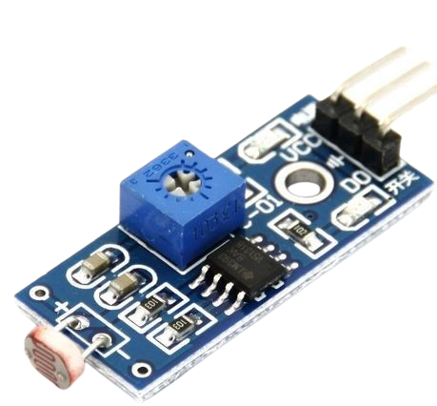
Photoresistive sensor
Easy to install
Low cost
Photocells
Digital
Ambient
Color
UV Light
Wide Detection Range
Customizable
Versatile Application

Slide 3
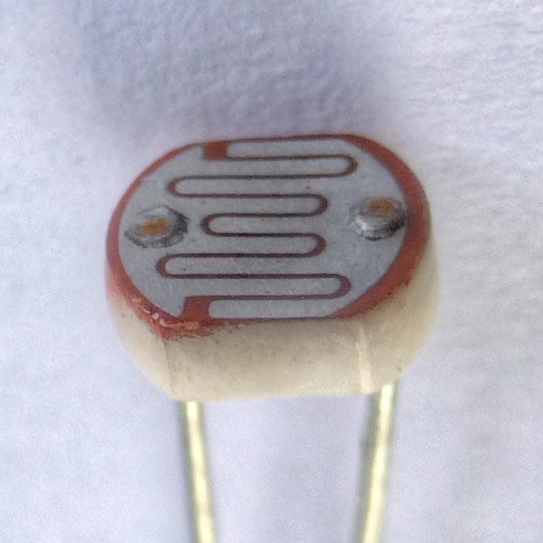
Conduction band
Energy gap
Valence band
Energy Bands

Slide 4
Conduction band
Output: Voltage
Energy gap
Valence band
Energy Bands

Slide 5
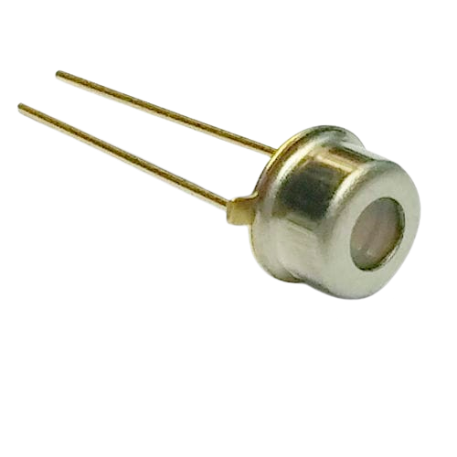




Use cases
Solar tracking system
Display Brightness Control
Automated Light system
Security and Alarm Systems
Photodiode

Slide 6
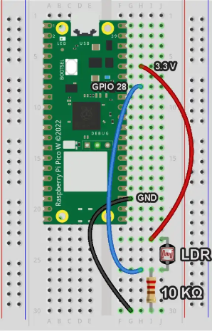
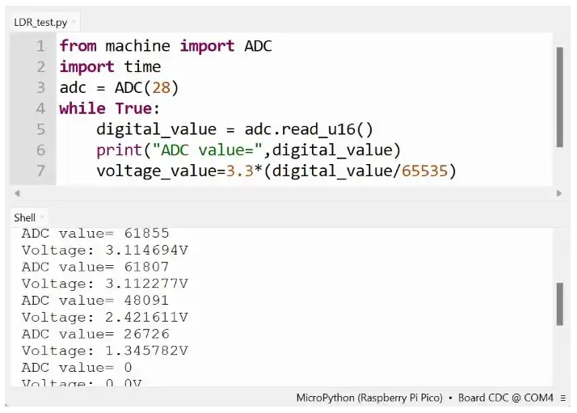
Application

